Slide 1
The Microprocessor
(CPU)
The Microprocessor
10/04/10

Slide 2
Introduction
The processor is the "brain" of the computer, it does the fundamental computing (calculating and processing).
It directly or indirectly controls all the other components in the system.
The processor is often the most expensive single component in the system.
The Microprocessor
10/04/10

Slide 3
Introduction
The processor is an electronic device about one inch square, covered in plastic. Inside the square is an even smaller square of silicon containing millions of tiny electrical parts called transistors.
A processor may contain 100 or more, million transistors. Transistors are small electronic switches whose on/off positions form binary codes.
The Microprocessor
10/04/10

Slide 4
Introduction
Other components from which ICs (including microprocessor) are made include: diodes, resistors, capacitors and wires
These components are constructed from
  Silicon - semiconductor
  Copper - conductor
  Silicon dioxide - insulator
The Microprocessor
10/04/10

Slide 5
Introduction
Intel created the first microprocessor in 1971 (a chip called the 4004).
Today Intel still has control over the processor market, at least for PCs.
This means that all PC-compatible systems use either Intel processors or Intel-compatible processors from AMD or VIA/Cyrix.
The Microprocessor
10/04/10

Slide 6
Introduction
On the motherboard, the CPU is contained on a single integrated circuit (IC) called the microprocessor.
Read about the history of the microprocessor
The Microprocessor
10/04/10

Slide 7

The Microprocessor
10/04/10

Slide 8

The Microprocessor
10/04/10

Slide 9

The Microprocessor
10/04/10

Slide 10
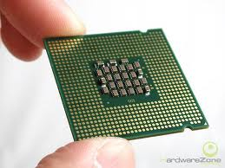
The Microprocessor
10/04/10

Slide 11
Processor Characteristic
Core speed
FSB- Data path, It has to be compatible with the motherboard speed, the common ones are up 800MHZ- 1066
Speed - MHZ
Datapath - Bit wide
Cache –L1 L2 L3
Multiprocessor and dual core processors.
The Microprocessor
10/04/10

Slide 12
Microprocessor Building Blocks
The microprocessor is made up of three basic components:
  The control unit (CU)
  The Arithmetic/Logical Unit (ALU).
  Floating point Unit (FPU)
A 4th component, the I/O unit (Bus Interface Unit), fetches data from the outside and passes data back to the external data bus.
The Microprocessor
10/04/10

Slide 13


The Layout of the Microprocessor Components
Data
Cache
Memory
bus
Control
Unit
ALU
Unit
Registers
RAM
Bus
Interface
Unit
Instruction
Decoder
I/O
FPU
Registers
System
bus
Instruction
Cache
The Microprocessor
10/04/10

Slide 14
The Control Unit
Functions of the control unit:
  instructs the computer system on how to follow program instructions.
  directs the movement of data to and from processor memory.
  temporarily holds data, instructions, and processed information
  directs control signals between the CPU and external devices such as hard disks, main memory, and I/O ports.
The Microprocessor
10/04/10

Slide 15
Arithmetic/Logic Unit (ALU)
The ALU performs both arithmetic and logical operations.
  Arithmetic operations are fundamental math operations like addition, subtraction, multiplication, and division.
  Logical operations (e.g., AND, NOT, OR, and XOR) for decisions
  Comparison operations (less than, greater than, equal to, etc)
The Microprocessor
10/04/10

Slide 16
Arithmetic/Logic Unit (ALU)
Modern microprocessors may have more than one ALU that can do simultaneous calculations – doubling the capability.
Floating Point Unit (FPU)/Numeric Unit
Performs calculations involving numbers represented in the scientific notation (also called floating point numbers)
The Microprocessor
10/04/10

Slide 17
Floating Point Unit (FPU)
This notation can represent extremely small and extremely large numbers in a compact form.
Floating point calculations are used to do graphics, engineering and scientific work.
The ALU can do these calculations as well, but will do them very slowly.
The Microprocessor
10/04/10

Slide 18
The Bus Interface
Receives data and instructions from the main memory.
The instructions are then sent to the instruction cache, data to the data cache.
Also receives the processed data and sends it to the main memory.
The Microprocessor
10/04/10

Slide 19
Instruction Decoder
This unit receives the programming instructions and decodes them into a form that is understandable by the processing unit (ALU and FPU).
Then, it passes the decoded instruction to the ALU or FPU
The Microprocessor
10/04/10

Slide 20
Registers
Both the ALU and FPU have very small amount of super-fast private memory placed right next to them for their exclusive use – called registers
The ALU and FPU store intermediate and final results from their calculations in these registers
Processed data goes back to the data cache and then to main memory
The Microprocessor
10/04/10

Slide 21
Language of Microprocessors:Instruction Set
Is the set of machine instructions that a microprocessor recognizes and can execute – the only language microprocessors know
An instruction set includes low-level, single step-at-a-time instructions, such as add, subtract, multiply, and divide
Each microprocessor family has its unique instruction set
The Microprocessor
10/04/10

Slide 22
The Microprocessor
The processor handles most of the operations that are required of the computer by processing instructions, sending signals out, checking for connectivity, and ensuring that operations and hardware are functioning properly.
The Microprocessor
10/04/10

Slide 23
The Microprocessor
The processor acts as a messenger to components such as the RAM, the monitor, and the disk drives.
The microprocessor is connected to the rest of the computer system through 3 buses
  the data bus
  the address bus and
  the control bus.
The Microprocessor
10/04/10

Slide 24
Processor Specifications
Processors can be identified by two main parameters: how wide they are and how fast they are
Speed is measured in megahertz (MHz) and gigahertz (GHz) - which means millions and billions, respectively, of cycles per second - and faster is better
The Microprocessor
10/04/10

Slide 25
Processor Specifications
Three main specifications in a processor that are expressed in terms of width are:
  Data or I/O bus (FSB, PSB, or CPU bus)
  Address bus
  Internal registers
All modern processors have 64-bit data bus (that does not mean they are 64-bit processors)
The Microprocessor
10/04/10

Slide 26
Processor Specifications
Pentium 4 and Athlon XP are 32-bit processors because their internal registers are 32-bits wide, although their data I/O bus is 64 bits wide and their address bus is 36-bits wide
The Itanium series and the AMD Opteron & Athlon 64 are 64-bit processors because their internal registers are 64 bits wide
The Microprocessor
10/04/10

Slide 27
Data I/O Bus
The speed and width of the external data bus (bundle of wires (or pins) used to send and receive data) are some of the most important features of a processor
The speed and width of the data bus defines the rate at which data can be moved into or out of the processor
The Microprocessor
10/04/10

Slide 28
Data I/O Bus
The more signals that can be sent at the same time, the more data can be transmitted in a specified interval and, therefore, the faster the bus
Data in a computer is sent as digital information consisting of a time interval in which a single wire carries 3.3V or 5V to signal a 1 data bit or 0V to signal a 0 data bit.
The Microprocessor
10/04/10

Slide 29
Data I/O Bus
The more wires you have, the more individual bits you can send in the same time interval
All modern processors from the original Pentium through the latest Pentium 4, Athlon XP, Athlon 64, and even the Itanium series have a 64-bit (8-byte) wide data bus
The Microprocessor
10/04/10

Slide 30
Data I/O Bus
They can transfer 64 bits of data at a time to/from the chipset or system memory
The width of the data bus also defines the size of a bank of memory. A processor with 32-bit data bus reads/writes memory 32 bits at a time, whereas a processor with 64-bit data bus reads/writes memory 64 bits at a time
The Microprocessor
10/04/10

Slide 31
Address Bus
The address bus is the set of wires that carries addressing information used to describe the memory location to which data is being written or from which data is being read
Each wire in an address bus carries a single bit of information. This single bit is a single digit in the address
The Microprocessor
10/04/10

Slide 32
Address Bus
The more wires (digits) used in calculating these addresses, the greater the total number of address locations
The size (or width) of the address bus indicates the maximum amount of RAM a chip can address
The Microprocessor
10/04/10

Slide 33
Address Bus
The sizes of the buses provide important information about a chip’s relative power, measured in two important ways.
  The size of the data bus is an indication of the chip’s information-moving capability, and
  The size of the address bus tells you how much memory the chip can handle
The Microprocessor
10/04/10

Slide 34
Internal Registers
(Internal Data Bus)
The size of the internal registers indicates how much data the processor can operate on at one time and how it moves data around internally within the chip
A register is a holding cell within the processor
The Microprocessor
10/04/10

Slide 35
Internal Registers
(Internal Data Bus)
The register size also describes the type of software or commands and instructions a chip can run
That is, processors with 32-bit internal registers can run 32-bit instructions that are processing 32-bit chunks of data, but processors with 16-bit registers can’t
The Microprocessor
10/04/10

Slide 36
Internal Registers
(Internal Data Bus)
Most advanced processors today use 32-bit internal registers and can therefore run the same 32-bit operating system and software
The Itanium and Athlon 64 processors have 64-bit internal registers, which require new operating system and software to fully be utilized
The Microprocessor
10/04/10

Slide 37
Internal Registers
(Internal Data Bus)
Internal registers often are larger than the data bus, which means the chip requires two cycles to fill a register before the register can be operated on
  E.g., the Pentium processor has an internal register that is larger than the size of the data bus i.e., 64-bit data bus and 32-bit internal registers
The Microprocessor
10/04/10

Slide 38
Internal Registers
(Internal Data Bus)
This is because the Pentium has two internal 32-bit pipelines for processing information (the Pentium is like two 32-bit chips in one)
The Microprocessor
10/04/10

Slide 39
Processor Modes
All Intel/Intel-compatible 32-bit processors (from 386 on) can run in several modes
Processor modes refer to the various operating environments and affect the instructions and capabilities of the chip
The processor mode controls how the processor sees and manages the system memory and the tasks that use it
The Microprocessor
10/04/10

Slide 40
Assigmnent Processor Modes
The 3 main modes (sub-modes) are:
Real mode (16-bit software)
IA-32 mode:
  Protected mode (32-bit software)
  Virtual real mode (16-bit programs within a 32-bit environment)
IA-32e 64-bit extension mode:
  64-bit mode (64-bit software)
  Compatibility mode (32-bit software)
The Microprocessor
10/04/10

Slide 41
Processor Speed Ratings
Processor speed measures, in MHz or GHz, the number of instructions per second the computer executes
CPU descriptions such as Pentium 133, Pentium 166, or Pentium 200 are specifications that indicate the maximum operating speed at which the CPU can execute instructions reliably
The Microprocessor
10/04/10

Slide 42
Processor Speed Ratings
The CPU speed is controlled by an external clock located on the board, not the microprocessor
The CPU speed is determined by the frequency of the clock signal (clock speed)
Clock speed is the rate at which a processor can complete processing cycles; measured in MHz or GHz
The Microprocessor
10/04/10

Slide 43
Processor Speed Ratings
One MHz is 1 million cycles per second, while 1 GHz is 1 billion cycles per second
This means a 1.8 GHz processor has twice the clock speed of a 900 MHz processor
However, a 1.8 GHz CPU is not necessarily twice as fast as a 900 MHz processor
The Microprocessor
10/04/10

Slide 44
Processor Speed Ratings
This is because different processors often use different architectures
  E.g., one processor may require more clock cycles to complete a multiplication instruction than another
If the 1.8 GHz CPU can complete a multiplication instruction in 4 cycles, while the 900 MHz CPU takes 10 cycles, the 1.8 GHz CPU is more than twice as fast as the 900 MHz processor
The Microprocessor
10/04/10

Slide 45
Processor Speed Ratings
For this reason, a 1.4 GHz Pentium 4 performs better than a 1.4 GHz Pentium III, but is not as fast as a 1.4 GHz Power PC G4 processor
Other factors, such as a computer's bus speed, cache size, speed of the RAM, and hard drive speed also contribute to the overall performance of the machine.
The Microprocessor
10/04/10

Slide 46
Processor Speed Ratings
While the processor's clock speed is a significant indicator of how fast a computer is, it is certainly not the only thing that matters.
Processor speeds of as high as 3.0 gigahertz (3000 MHz) and higher, are available.
The Microprocessor
10/04/10

Slide 47
Processor Speed Ratings
Three factors that determine how much information can be processed at any given time by the processor include:
  The size of the internal bus/registers
  The size of the address bus
  The processor speed ratings
The Microprocessor
10/04/10

Slide 48
Processor Speeds vs Motherboard Speeds
Another confusing factor when comparing processor performance is that virtually all modern processors run at some multiple of the board speed
  E.g, a Pentium 4 (2.53GHz) chip runs at a multiple of 4.75x times the board speed of 533MHz, whereas an AMD Athlon XP (2.083GHz) runs at 6.25x times the board speed of 333MHz
The Microprocessor
10/04/10

Slide 49
Processor Speeds vs
Motherboard Speeds
Therefore, the CPU speed and the frequency of the clock signal are not always at a 1-to-1 ratio
You can set the motherboard speed and multiplier setting via jumpers or another configuration mechanism (such as BIOS setup) on the motherboard
The Microprocessor
10/04/10

Slide 50
Processor Speeds vs
Motherboard Speeds
Modern systems use a variable-frequency synthesizer circuit found in the main board chipset to control the board and CPU speed
Most Pentium boards have 3 or 4 speed settings
Modern processors are available in a variety of versions that run at different frequencies based on a given board speed
The Microprocessor
10/04/10

Slide 51
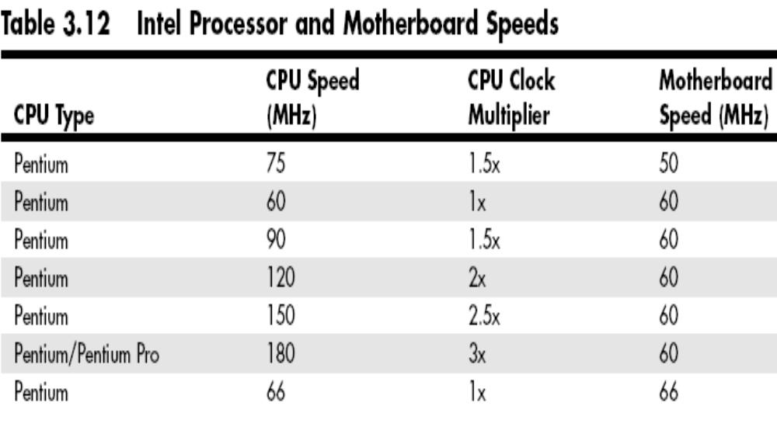
Processor Speeds vs
Motherboard Speeds
The Microprocessor
10/04/10

Slide 52
Reading
Processor stepping & Over clocking.
Other processor features such as System Management Mode (SMM), Superscalar Execution, MMX, SSE, 3DNow!, and HT Technology.
Processor upgrades
Troubleshooting processors
Latest kinds of processors on the market
The Microprocessor
10/04/10

Slide 53
Questions
Differentiate between a 64-bit system and a 32-bit system.
Give reasons why a processor with a clock rating of 1.8 GHz may be more than twice as fast as another of 900 MHz?
What are the two classes of RAM, and how do they differ from each other?
The Microprocessor
10/04/10

Slide 54
Pentium Processors
The current family of the Intel Pentium microprocessors includes Pentium II, Pentium III, Pentium 4, Xeon, Multimedia Extensions (MMX), Celeron, Itanium series and Core 2
The Core 2 class is the current standard for processor chips
The Microprocessor
10/04/10

Slide 55
Pentium Processors
By combining memory cache with microprocessor circuitry, the Pentium supports speeds of up to or greater than 3000 MHz
Improved features of the Pentium processors over their predecessor, which evolved from the Intel 80486 include:
The Microprocessor
10/04/10

Slide 56
Pentium Processors
  Pentium processors have data bus that is 64 bits wide and can take in data 64 bits at a time, unlike the Intel 486 with 32 bits
  Pentium processors have multiple caches of storage (L1 and L2 cache or even L3) adding up to 2 MB, unlike the 8 kilobytes of the Intel 486.
High CPU speed means components can get data in/out of the chip quickly
The Microprocessor
10/04/10

Slide 57
Pentium Processors
The processor does not become idle waiting for data or instructions
This enables the software to run faster
These components need to handle the flow of information through the CPU, interpret instructions so the CPU can execute them, and send the results back to the PC memory
The Microprocessor
10/04/10

Slide 58
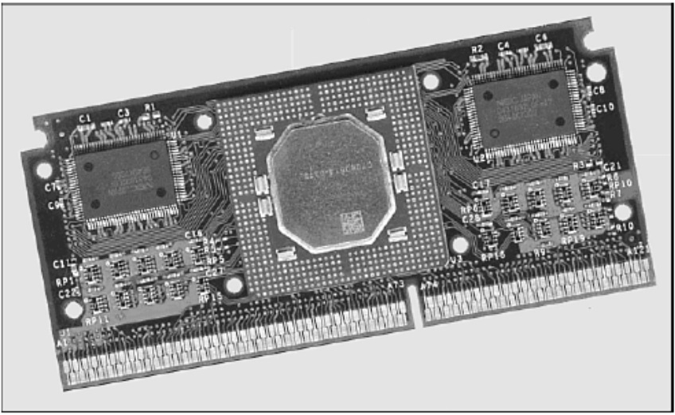
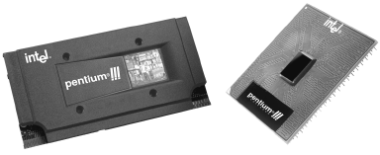
Pentium II/III Processor
The Microprocessor
10/04/10

Slide 59
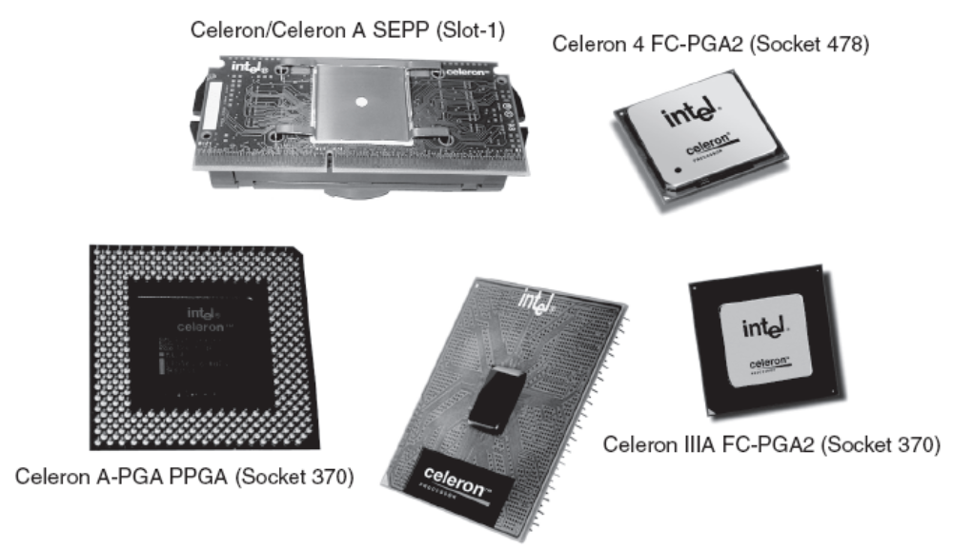
Celeron Brand Processors
The Microprocessor
10/04/10

Slide 60
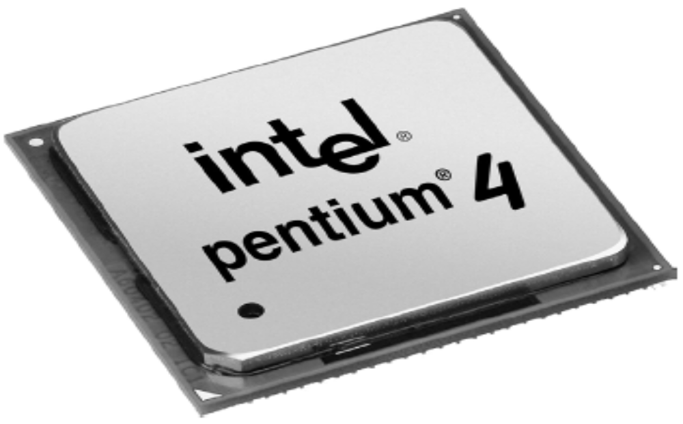
The Pentium 4
The Microprocessor
10/04/10

Slide 61
Intel Core 2 family of processors
The Core 2 family comes in four flavors:
  Core 2 Solo – a single-core mobile CPU; replaces Pentium M
  Core 2 Duo – a dual-core CPU; replaces Pentium 4 and Pentium D
  Core 2 Quad – a quad-core Core 2 Duo
  Core 2 Extreme – replaces Pentium Extreme Edition and has models with two and four cores
The Microprocessor
10/04/10

Slide 62
Some Features of Core 2 family
Based on new Core microarchitecture, replacing Netburst microarchitecture, used on Pentium 4 and CPU's based on it
32 KB instruction L1 cache and 32 KB data L1 memory cache for each core
Socket 775 on desktop models (except Core 2 Extreme QX9775, which uses socket 771)
2 MB, 3 MB, 4 MB or 6 MB unified L2 cache
Intel Virtualization Technology
SSE3 instruction set
The Microprocessor
10/04/10

Slide 63
AMD Processors
The best performing AMD processors are the Athlon, Athlon XP, Thunderbird, and Duron series
Like the Intel Pentium III, these AMD processors are currently the most used microprocessors in high-end desktop systems, workstations, and servers
The Microprocessor
10/04/10

Slide 64
AMD Processors
The AMD Athlon processor system bus is designed for scalable multiprocessing
The number of AMD Athlon processors in a multiprocessor system is determined by chipset implementation
The Microprocessor
10/04/10

Slide 65
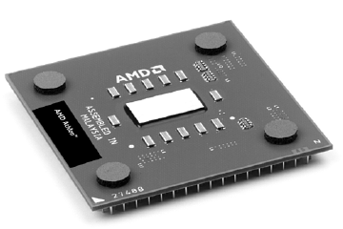
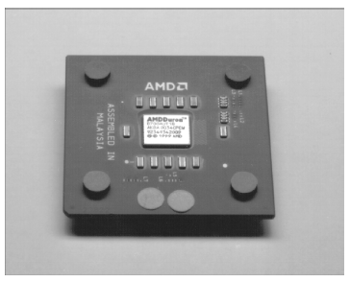
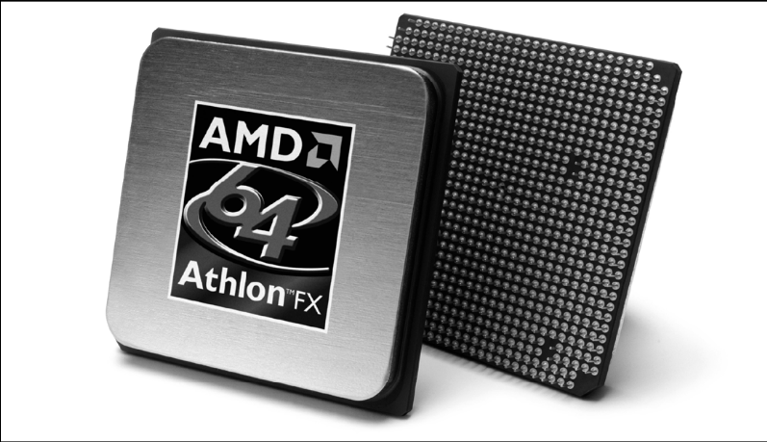
AMD Duron and Athlon XP
The Microprocessor
10/04/10

